Slide 1
Pre-lab Questions(4 points each)

Slide 2
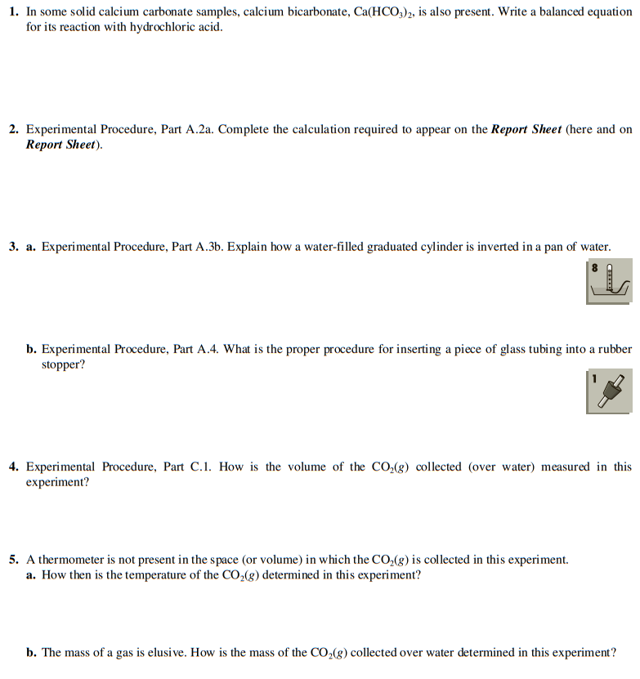

Slide 3
Laboratory Reports
Use the format in manual(page 24~27).

Slide 4
Post-lab Questions
(3 points each, maximum 20 points)

Slide 5
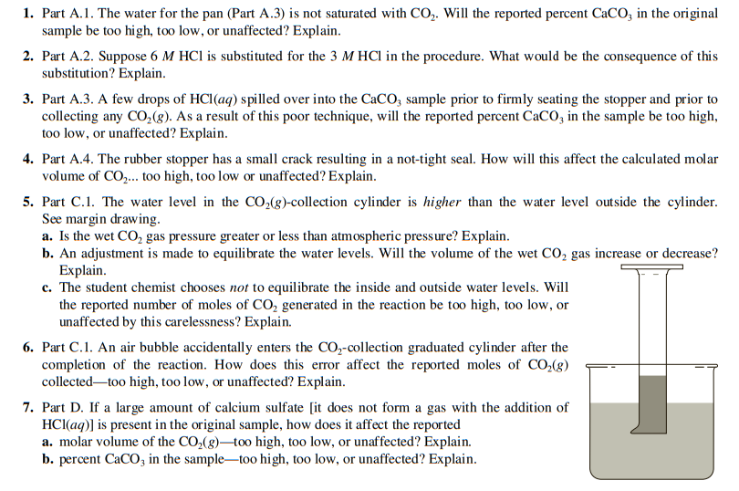

Slide 6
Textbook Content for Exp. 4

Slide 7
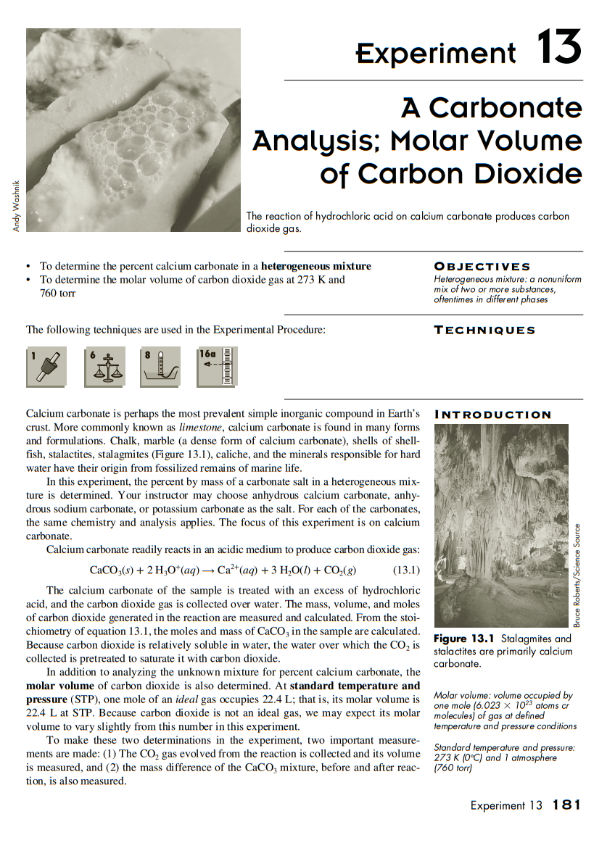
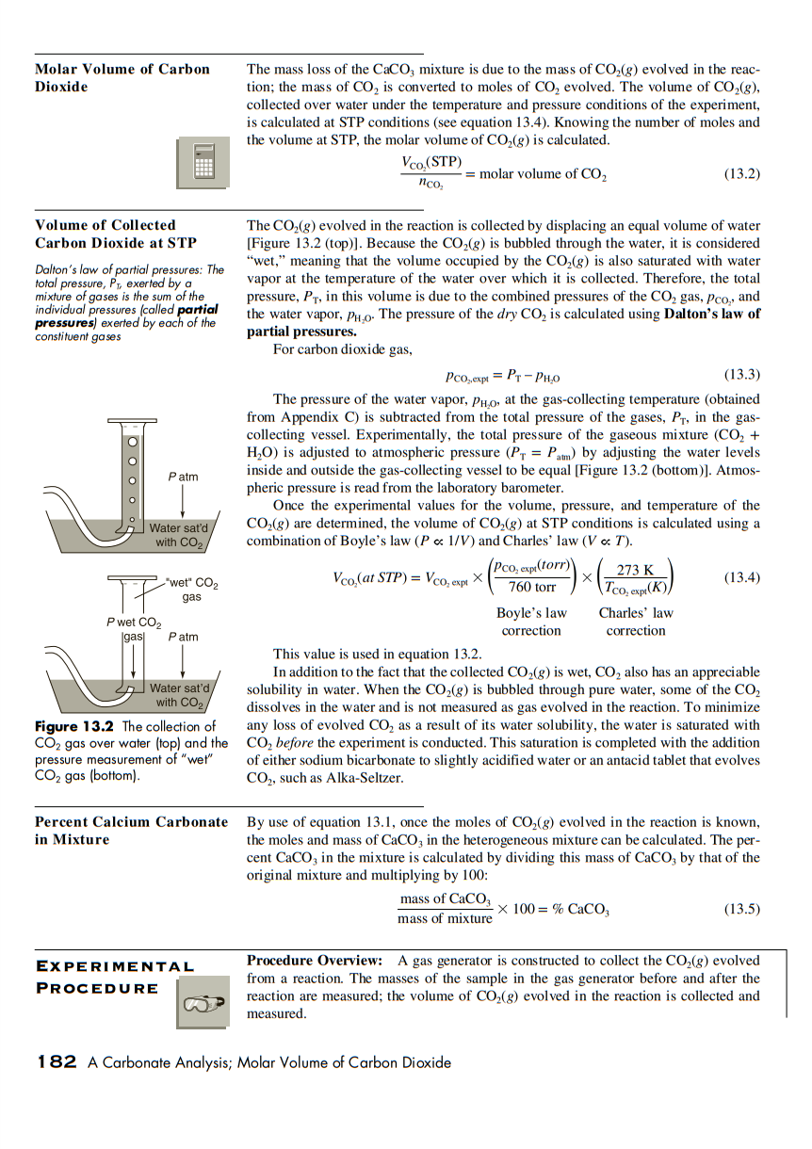

Slide 8
